Slide 1











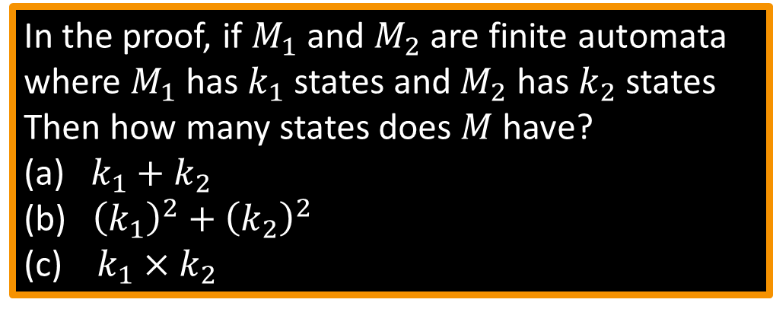
Closure Properties for Regular Languages: Union
Theorem: If ${ A}_{1}, A_{2}$are regular languages, so is $A_{1}∪A_{2}$ (closure under $∪$)
Proof: Let $M_{1}=(Q_{1}, Σ, { δ}_{1}, { q}_{1}, { F}_{1})$ recognize $A_{1}$ $M_{2}=(Q_{2}, Σ, { δ}_{2}, { q}_{2}, { F}_{2})$ recognize $A_{2}$
Construct $M = (Q, Σ, δ, q0, F)$ recognizing ${A_{1}∪A}_{2}$ $M$ should accept input $w$ if either $M_{1}$ or $M_{2}$ accept $w$.
In the proof, if $M_{1}$ and $M_{2}$ are finite automata where $M_{1}$ has $k_{1}$ states and $M_{2}$ has$k_{2}$ states
Then how many states does $M$have?
(a) $k_{1}+k_{2}$
(b) ${\left(k_{1}\right)}^{2}+{\left(k_{2}\right)}^{2}$
(c) $k_{1}×k_{2}$
Components of $M$:
$Q=Q_{1}×Q_{2}$ $=\left\{\left(q_{1},q_{2}\right)\right|q_{1}∈Q_{1}$ and $q_{2}∈Q_{2}\}$
$q_{0}=(q_{1}, q_{2})$
$δ\left(\left(q_{1}, q_{2}\right),a\right)=\left(δ_{1}\left(q_{1},a\right),δ_{2}\left(q_{2},a\right)\right)$
$F=F_{1}×F_{2}$
$F=\left(F_{1}×Q_{2}\right)∪\left(Q_{1}×F_{2}\right)$
$$M_{1}$$
$$q1$$
$$q$$
$$M$$
?
$q1$, $q2$
$$q,r$$
$$M_{2}$$
$$q2$$
NO! [gives intersection]
$$r$$
Notes:
Closure: When we apply the property it still belongs to that.
1 belongs to a positive number, 3 belongs to a positive number and 1+3 also belongs to a positive number. So addition is closure to a positive number.
However, subtraction does not belong to positive numbers. 1 belongs to a positive number, 3 belongs to a positive number but 1-3 is not a positive number.
Ans: Number of states: (c) k1 x k2
Ex: Machine 1 states: 2,3,4 and Machine 2 states: 6,7 : Total states: (2,6), (2,7), (3,6), (3,7), (4,6), (4,7)

Slide 2









Closure Properties for Regular Languages: Concatenation
Theorem: If ${ A}_{1}, A_{2}$are regular languages, so is $A_{1}A_{2}$ (closure under $∘$)
Proof: Let $M_{1}=(Q_{1}, Σ, { δ}_{1}, { q}_{1}, { F}_{1})$ recognize $A_{1}$ $M_{2}=(Q_{2}, Σ, { δ}_{2}, { q}_{2}, { F}_{2})$ recognize $A_{2}$
Construct $M = (Q, Σ, δ, q0, F)$ recognizing ${A_{1}A}_{2}$
$$M_{1}$$
$$M_{2}$$
$M$ should accept input $w$ if $w=xy$ where $M_{1}$ accepts $x$ and $M_{2}$ accepts $y$.
$$M$$
$$w$$
$$x$$
$$y$$
Doesn’t work: Where to split $w$?
Hold off. Need new concept.
Notes:
Ex:
A1 = {w | w contains 11}
A2 = {w | w contains 10}
A1.A2: 0100111011 -> We don’t know where to divide.
With DFA we can not decide where to divide the string and pass it to the machine.
That’s why we need Non-Deterministic Finite Automata.

Slide 3
Nondeterministic Finite Automata
NFAs are theoretical computational models.
They used as tools for modeling and reasoning about computations and languages.
NFAs are particularly useful for representing non-deterministic decision-making processes, where multiple choices may lead to different outcomes.

Slide 4
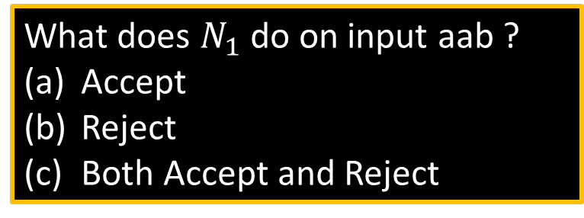





Nondeterministic Finite Automata
$$N1$$
a
a
b
a,ε
$$q4$$
$$q1$$
$$q2$$
$$q3$$
What does $N_{1}$ do on input aab ?
Accept
Reject
Both Accept and Reject
b
New features of nondeterminism: - multiple paths possible (0, 1 or many at each step)
- ε-transition is a “free” move without reading input
- Accept input if some path leads to accept
Example inputs:
- ab accept
- aa reject
- aba accept
- abb reject
Nondeterminism doesn’t correspond to a physical machine we can build. However, it is useful mathematically.

Slide 5







NFA – Formal Definition
$$N1$$
a
a
b
a,ε
$$q4$$
$$q1$$
$$q2$$
$$q3$$
b
Defn: A nondeterministic finite automaton (NFA) $N$ is a 5-tuple $(Q, Σ, δ, q0, F)$
- all same as before except $δ$
- $δ:Q×Σ_{\text{ε}}→𝓟\left(Q\right)=\left\{R\right|R⊆Q\}$
- In the $N_{1}$ example: $δ\left(q_{1},\text{a} \right)=\{q_{1},q_{2}\}$
$δ\left(q_{1},\text{b} \right)= ∅$
Ways to think about nondeterminism:
Computational: Fork new parallel thread and accept if any thread leads to an accept state.
Mathematical: Tree with branches. Accept if any branch leads to an accept state.
Magical: Guess at each nondeterministic step which way to go. Machine always makes the right guess that leads to accepting, if possible.
states
alphabet
start state
accept states
transition function
power set
$$Σ∪\{\text{ε}\}$$

